Slide 1



Quality - Innovation - Vision
Effective Metrics for Managing a Test Effort
    Presented By:
      Shaun Bradshaw
      Director of Quality Solutions
      Questcon Technologies
      November 9, 2006

Slide 2

Objectives
Why Measure?
Definition
Metrics Philosophy
Types of Metrics
Interpreting the Results
Metrics Case Study
Q & A
Notes:
Different meetings call for different slide focus. One company may need to understand QA better while other companies my understand QA but need focus on performance testing, etc.

Slide 3
Why Measure?
“Software bugs cost the U.S. economy
an estimated $59.5 billion per year.
An estimated $22.2 billion
could be eliminated by
improved testing that enables
earlier and more effective
identification and removal of defects.”
- US Department of Commerce (NIST)

Slide 4
Why Measure?
It is often said,
“You cannot improve what you
cannot measure.”

Slide 5
Definition
Test Metrics:
Are a standard of measurement.
Gauge the effectiveness and efficiency of several software development activities.
Are gathered and interpreted throughout the test effort.
Provide an objective measurement of the success
of a software project.

Slide 6
Metrics Philosophy
Keep It Simple
When tracked and used properly, test metrics can aid in software development process improvement by providing pragmatic & objective evidence of process change initiatives.
Make It Meaningful
Track It
Use It

Slide 7

Metrics Philosophy
Keep It Simple
Measure the basics first
Clearly define each metric
Get the most “bang for your buck”
Make It Meaningful
Track It
Use It

Slide 8
Metrics Philosophy
Metrics are useless if they are meaningless (use GQM model)
Must be able to interpret the results
Metrics interpretation should be objective
Keep It Simple
Make It Meaningful
Track It
Use It

Slide 9
Metrics Philosophy
Incorporate metrics tracking into
the Run Log or defect tracking system
Automate tracking process to remove time burdens
Accumulate throughout the test effort & across multiple projects
Keep It Simple
Make It Meaningful
Track It
Use It

Slide 10
Metrics Philosophy
Interpret the results
Provide feedback to the Project Team
Implement changes based on objective data
Keep It Simple
Make It Meaningful
Track It
Use It

Slide 11
Types of Metrics
Base Metrics
Examples
Raw data gathered by Test Analysts
Tracked throughout test effort
Used to provide project status and evaluations/feedback
# Test Cases
# Executed
# Passed
# Failed
# Under Investigation
# Blocked
# 1st Run Failures
# Re-Executed
Total Executions
Total Passes
Total Failures

Slide 12
Types of Metrics
Base Metrics
Examples
Raw data gathered by Test Analyst
Tracked throughout test effort
Used to provide project status and evaluations/feedback
# Test Cases
# Executed
# Passed
# Failed
# Under Investigation
# Blocked
# 1st Run Failures
# Re-Executed
Total Executions
Total Passes
Total Failures
# Blocked
The number of distinct test cases that cannot be executed during the test effort due to an application or environmental constraint.
Defines the impact of known system defects on the ability to execute specific test cases

Slide 13
Types of Metrics
Calculated Metrics
Examples
Tracked by Test Lead/Manager
Converts base metrics to useful data
Combinations of metrics can be used to evaluate process changes
% Complete
% Test Coverage
% Test Cases Passed
% Test Cases Blocked
1st Run Fail Rate
Overall Fail Rate
% Defects Corrected
% Rework
% Test Effectiveness
Defect Discovery Rate

Slide 14
Types of Metrics
Calculated Metrics
Examples
Tracked by Test Lead/Manager
Converts base metrics to useful data
Combinations of metrics can be used to evaluate process changes
% Complete
% Test Coverage
% Test Cases Passed
% Test Cases Blocked
1st Run Fail Rate
Overall Fail Rate
% Defects Corrected
% Rework
% Test Effectiveness
Defect Discovery Rate
1st Run Fail Rate
The percentage of executed test cases that failed on their first execution.
Used to determine the effectiveness of the analysis and development process. Comparing this metric across projects shows how process changes have impacted the quality of the product at the end of the development phase.

Slide 15
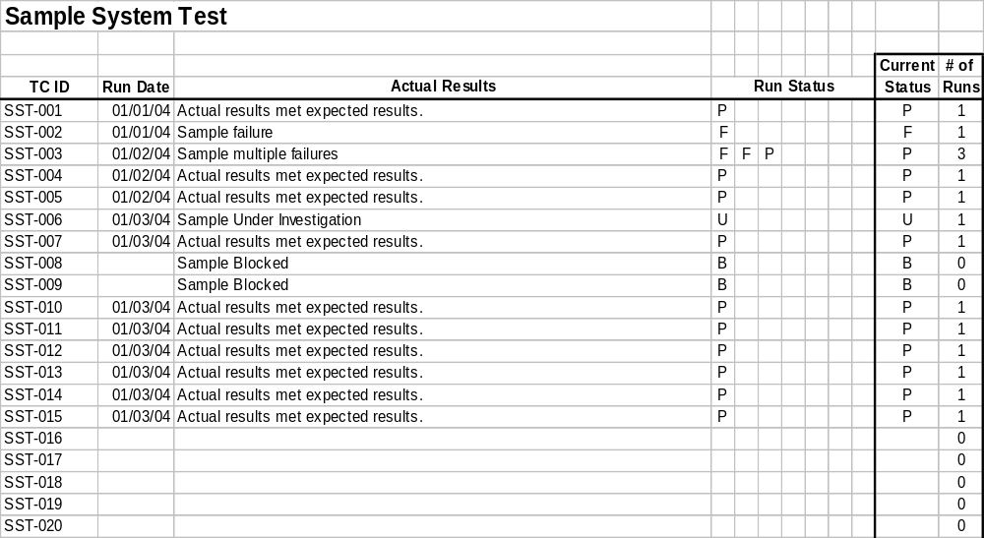
Sample Run Log

Slide 16
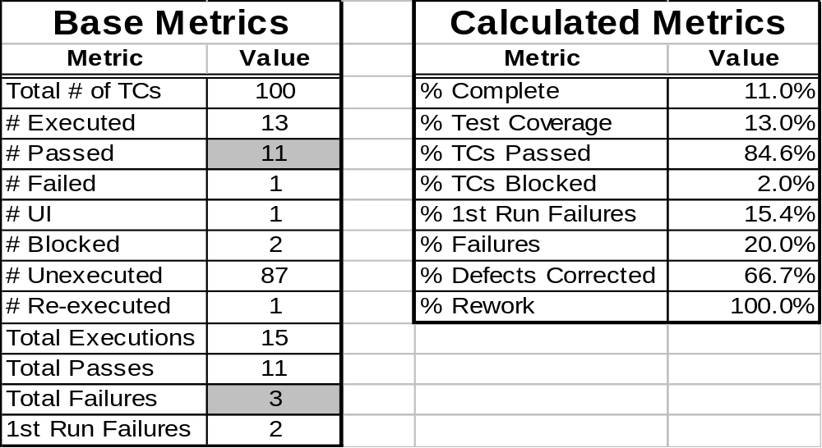
Sample Run Log

Slide 17

Metrics Program – No Analysis
Issue:
The test team tracks and reports various test metrics, but there is no effort to analyze the data.
Result:
Potential improvements are not implemented leaving process gaps throughout the SDLC. This reduces the effectiveness of the project team and the quality of the applications.

Slide 18

Metrics Analysis & Interpretation
Solution:
Closely examine all available data
Use the objective information to determine the root cause
Compare to other projects
  Are the current metrics typical of software projects in your organization?
  What effect do changes have on the software development process?
Metrics
Analysis
Result:
Future projects benefit from a more effective and efficient application development process.

Slide 19

Metrics Case Study
Volvo IT of North America had little or no testing involvement in its IT projects. The organization’s projects were primarily maintenance related and operated in a COBOL/CICS/Mainframe environment. The organization had a desire to migrate to newer technologies and felt that testing involvement would assure and enhance this technological shift.
While establishing a test team we also instituted a metrics program to track the benefits of having a QA group.

Slide 20
Metrics Case Study
Project V
Introduced a test methodology and metrics program
Project was 75% complete (development was nearly finished)
Test team developed 355 test scenarios
30.7% - 1st Run Fail Rate
31.4% - Overall Fail Rate
Defect Repair Costs = $519,000

Slide 21
Metrics Case Study
Project T
Instituted requirements walkthroughs and design reviews with test team input
Same resources comprised both project teams
Test team developed 345 test scenarios
17.9% - 1st Run Fail Rate
18.0% - Overall Fail Rate
Defect Repair Costs = $346,000

Slide 22
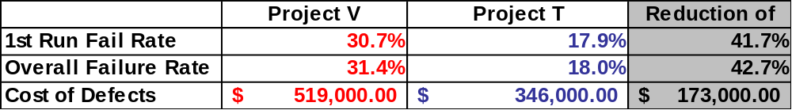
Metrics Case Study
Reduction of 33.3% in the cost of defect repairs
Every project moving forward, using the same
QA principles can achieve the same type of savings.

Slide 23

Q & A

